Slide 1
DATA ANALYTICS BOOTCAMP PROJECT 2
PROPOSAL 1 –
PROJECT MANAGEMENT APPLICATION

Slide 2
Overview
Create a Project Management Application with the following features:
Phase 1:
Web page to add and update Project Resources
Web page to add and update Project Work Breakdown Structure
Web page to view the Gantt Chart
Web page to display Project Dashboard
Saving and reading all data from a database
Bonus: Basic Augmented Reality – task summary for resource – marker-based
Phase 2 (time permitting):
Improve validation checks
Delete resources and tasks
User registration and login
Report export
Multiple projects
Program resource utilization
Document management
Enhanced Augmented Reality
The story:
Health of the project
Direction of project

Slide 3
Why a PMApp?
Python is so much more than data analysis only – why not learn to apply the broader capability?
Project Management is simply part of our everyday life – why not create our own application to manage our life?
Visualization is a very important part of Project Management – why not utilizing the tools we’re using to create a great dashboard and other visualizations?
The browser is an ideal tool to provide accessibility – why not use it to build a usable application?
We need to spend a lot of time on this project – why not built something that has value outside of the course?
Augmented Reality has been successfully applied to construction projects – why not think out-of-the-box a bit and apply it to general Project Management?

Slide 4
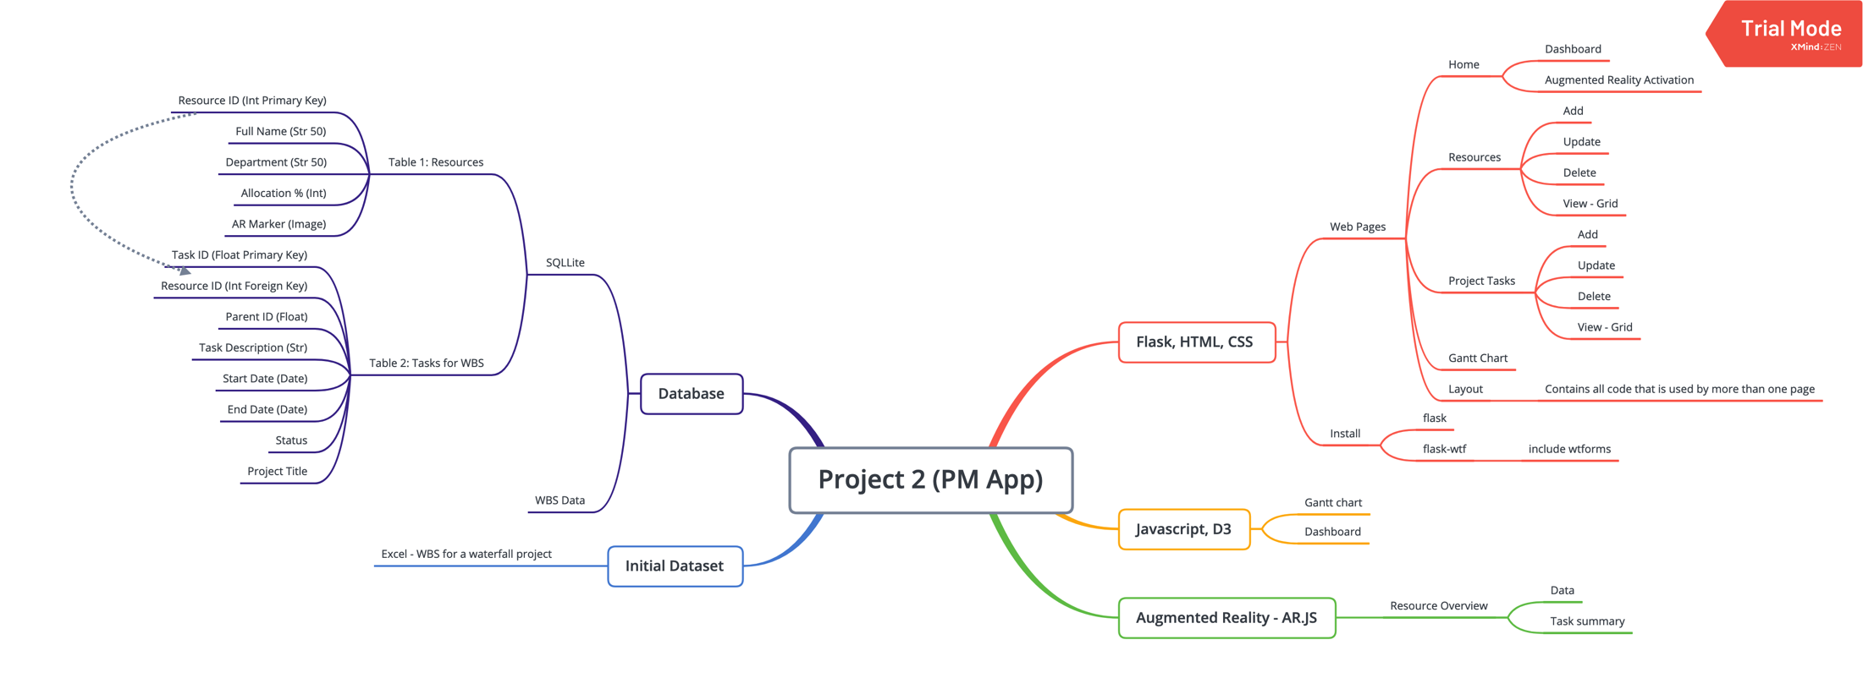
Meeting the Project Requirements

Slide 5
Meeting Project Requirements (continued)
Flask, HTML, CSS
Web pages (all user driven interaction):
Home: Dashboard; Augmented Reality
Resources: Add; Update; View
WBS: Add; Update: View
Other Charts: Gantt Chart
2. Javascript, D3
Dashboard (User driven interaction, and multiple views)
Gantt Chart
3. Database
SQLLite: Tables
Resources
Tasks
4. Dataset
WBS dataset with 200+ records
5. JS library not used before:
Ar.js

Slide 6
Outline of Story
The visualizations will outline the following:
- Is our project portfolio healthy?
- What problems do we have on our projects, or can expect soon?
- Are our resources over/under utilized?
- Can we add/remove projects, and when, and why?
- Should our resources be assigned more to projects rather than operations?
- Should we get more resources?
- Is our business in trouble?
- How busy is our organization outside of operations?

Slide 7
PLANNING

Slide 8
User Interaction
User interaction includes the following:
Resources: Add and updating Resource Data
Tasks: Adding and updating Task Data
Filters – all charts on the page updated according to filter:
Gantt Chart: All Projects/Specific Project, Start Date – End Date
Dashboard: All Projects/Specific Project, Start Date – End Date
Summary data on hover over graphs
Task summary with Augmented Reality

Slide 9
Dashboard Ideas
Portfolio and Project Pulse
- Graph showing length of projects stacked with # tasks per resource
- Graph showing length of project stacked with task status (aggregated into totals per status)
- Graph showing overdue tasks and tasks for selected period stacked by # of tasks per resource
- Resource allocation graph – see HR people graph example
- Scatter/Bubble plot for task distribution over time
- Portfolio and Project Fever Chart
- Sunburst graph (inside = project, 2nd level = resource, 3rd level = task status)
- 3D graph
- Joined and individual contributions
- Circular barplot (www.d3-graph-gallery.com/cicular_barplot.html)
- Dendogram & grouped horizontal bar chart

Slide 10
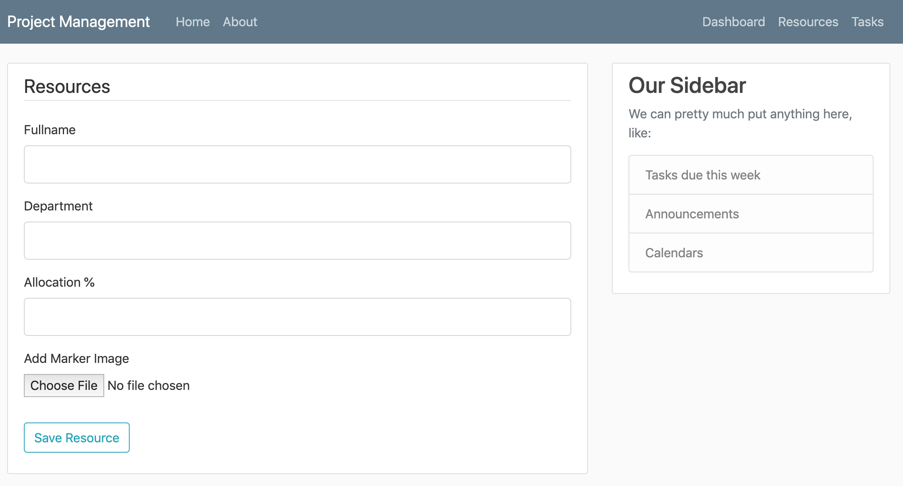
Resources Input Page

Slide 11
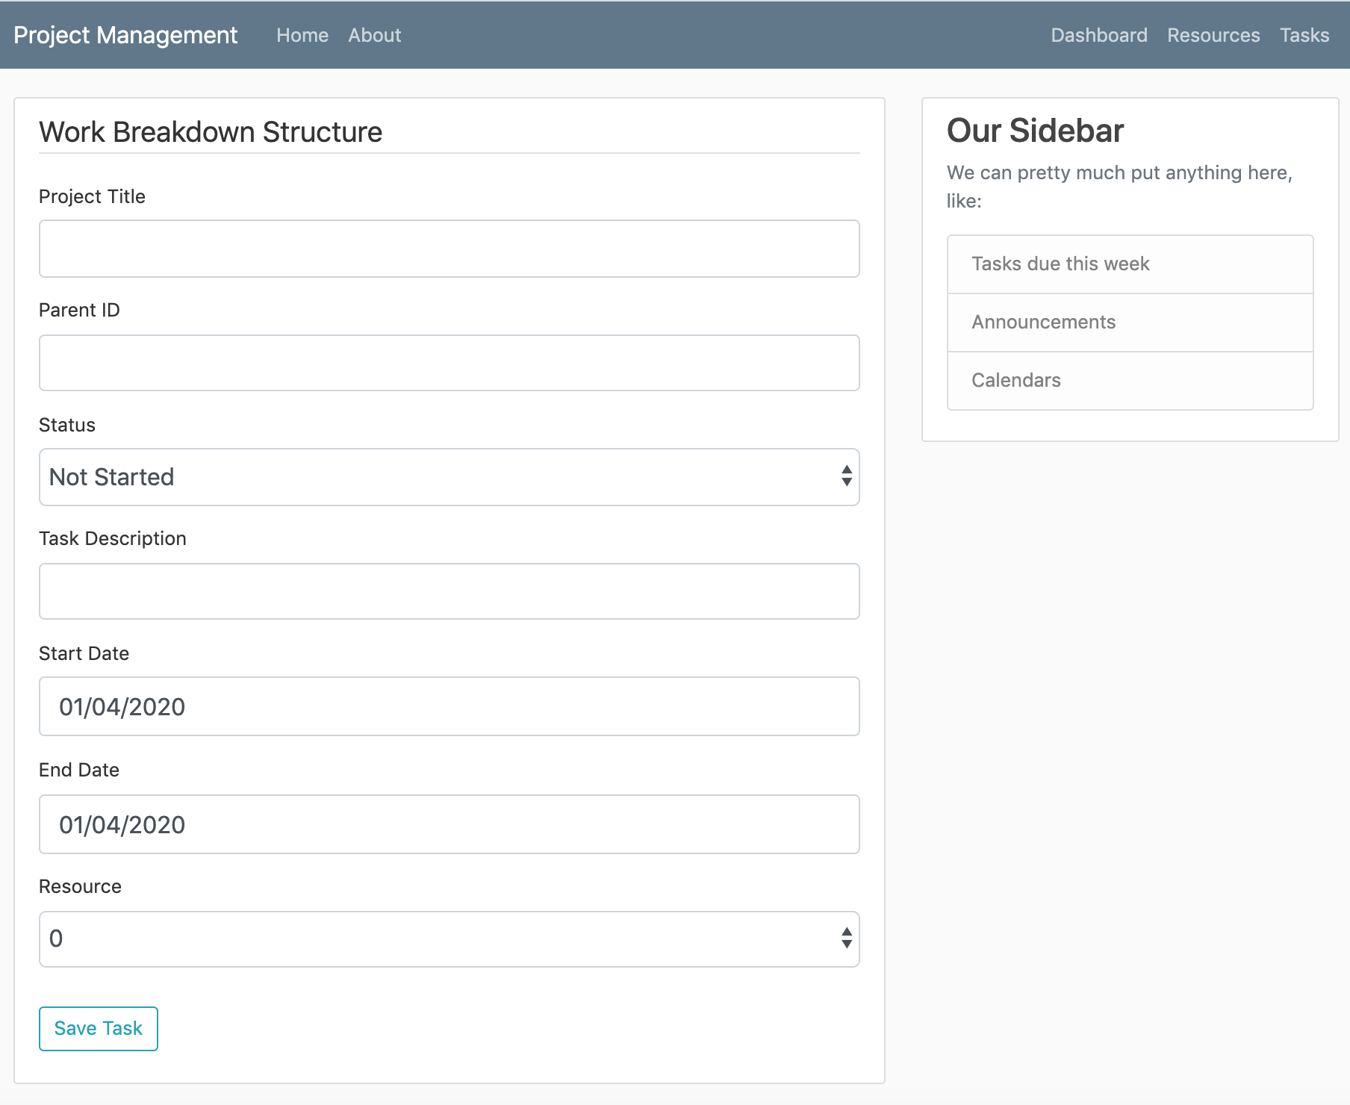
Tasks Input Page

Slide 12
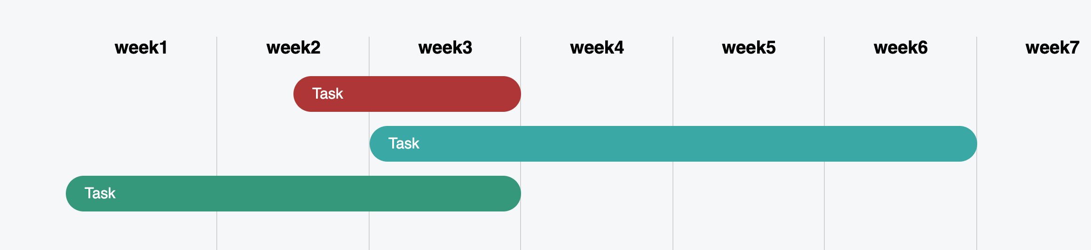
Simple Gantt Chart

Slide 13
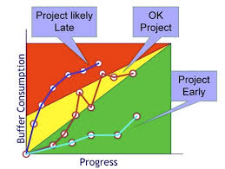
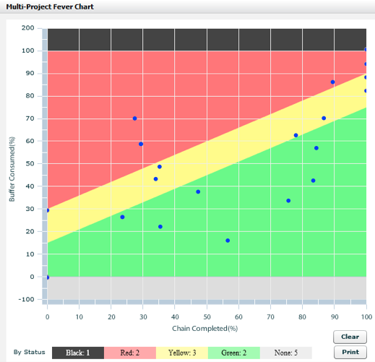
Sample Graphs and Dashboards
Project Fever Charts

Slide 14
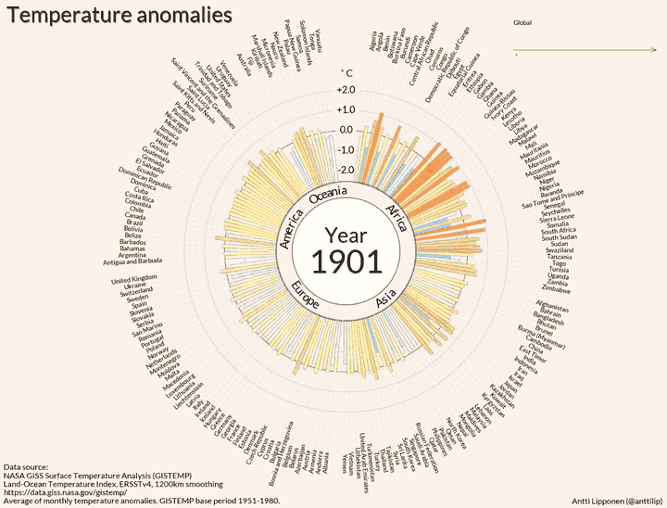
Sample Graphs and Dashboards
Circular Barplot
with animation

Slide 15
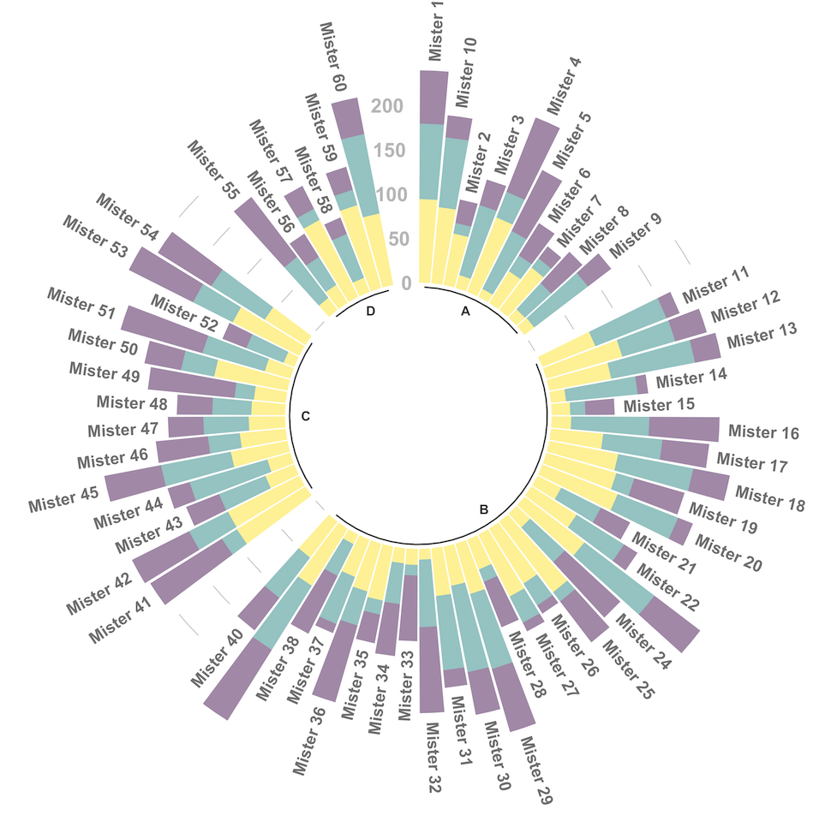
Sample Graphs and Dashboards
Circular Stacked Bar Plot

Slide 16
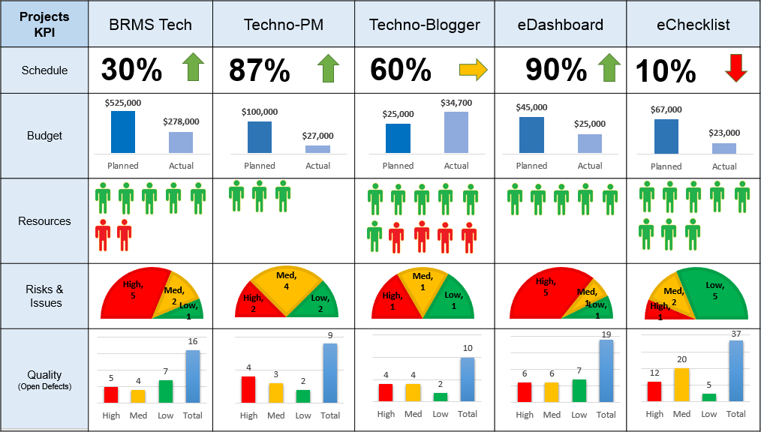
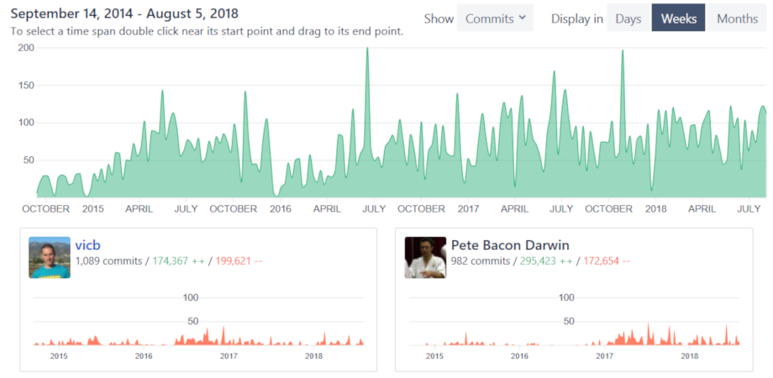
Sample Graphs and Dashboards
Interesting resource presentation
Individual and combined graph

Slide 17
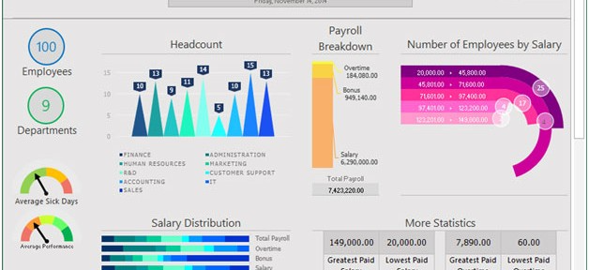
Sample Graphs and Dashboards
Colorful and different

Slide 18
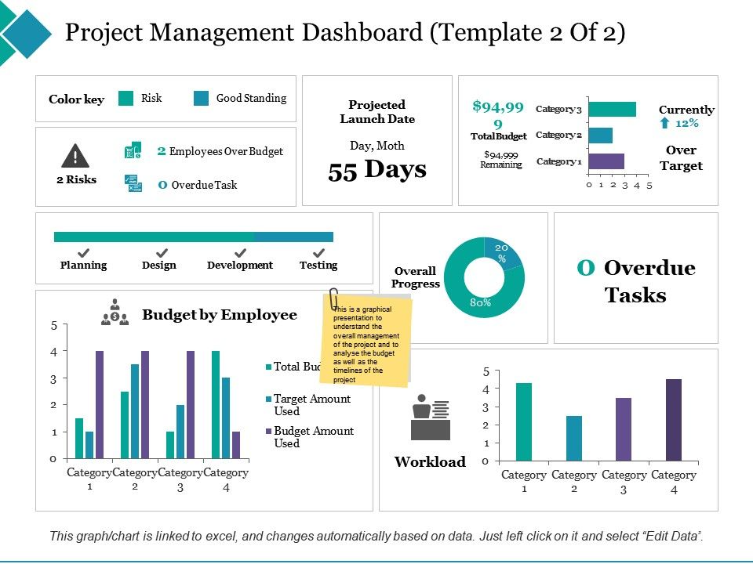
Sample Graphs and Dashboards
Tells a story

Slide 19
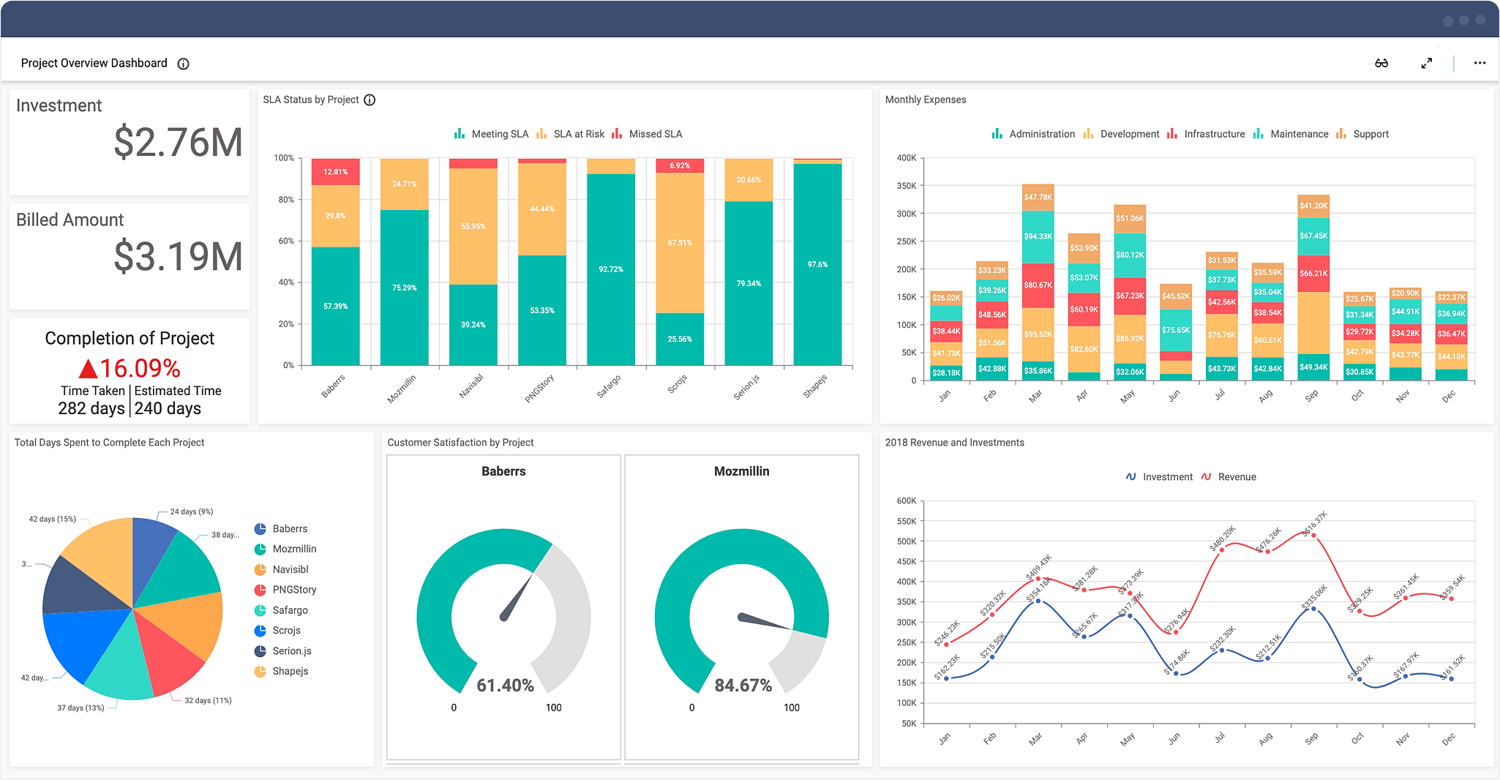
Sample Graphs and Dashboards
Lot of information on stacked bar plots

Slide 20
Sample Graphs and Dashboards
Interesting resource presentation
Individual and combined graph

Slide 21
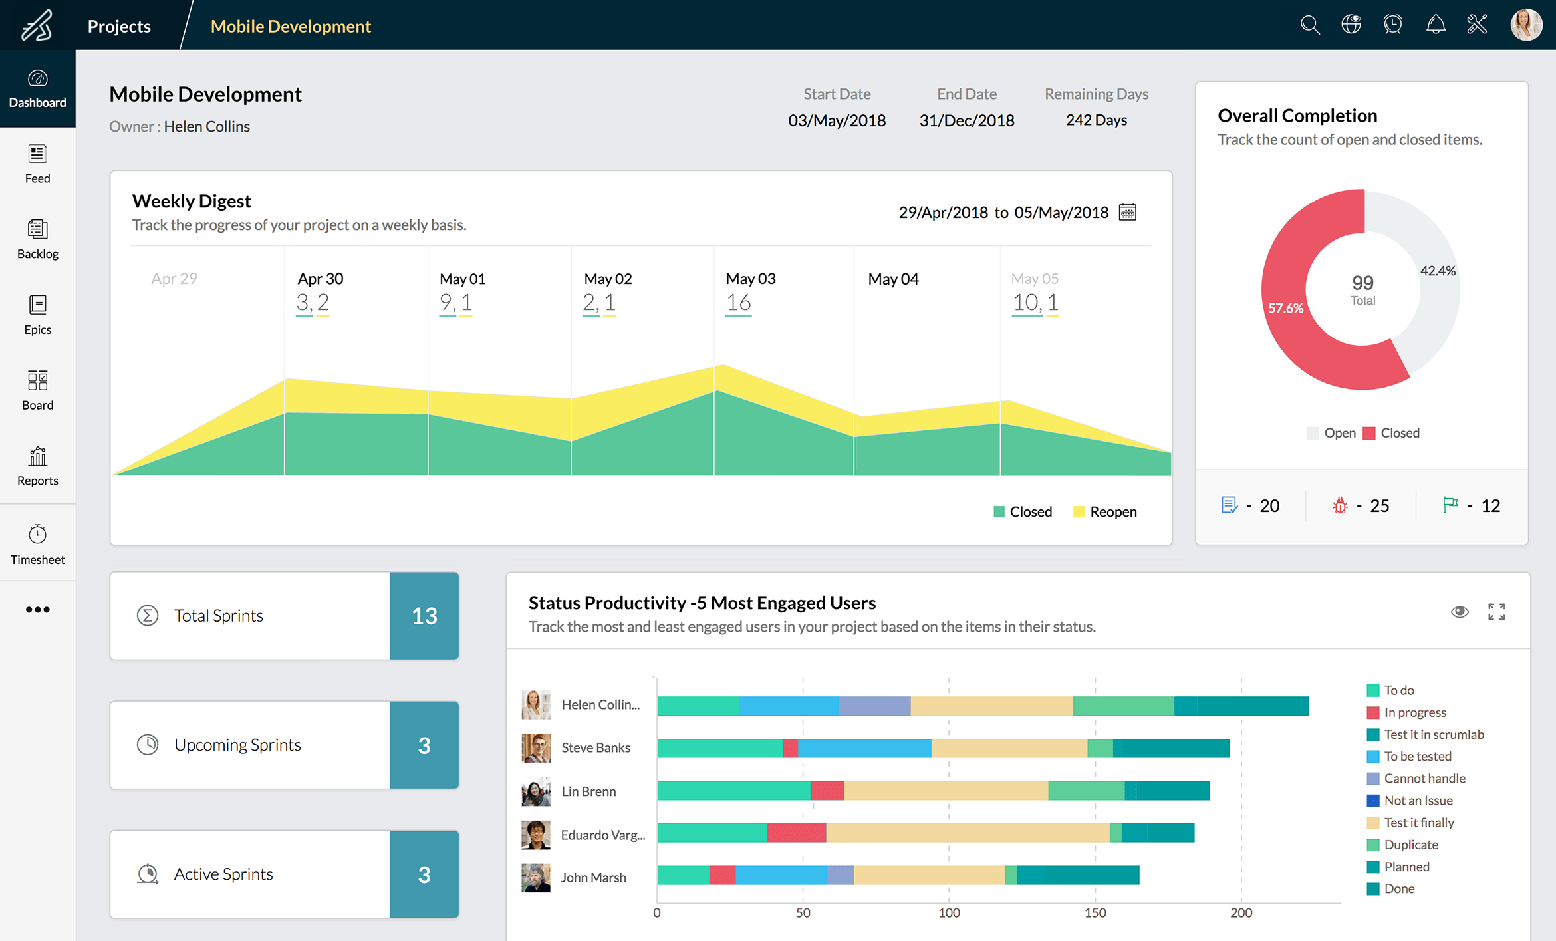
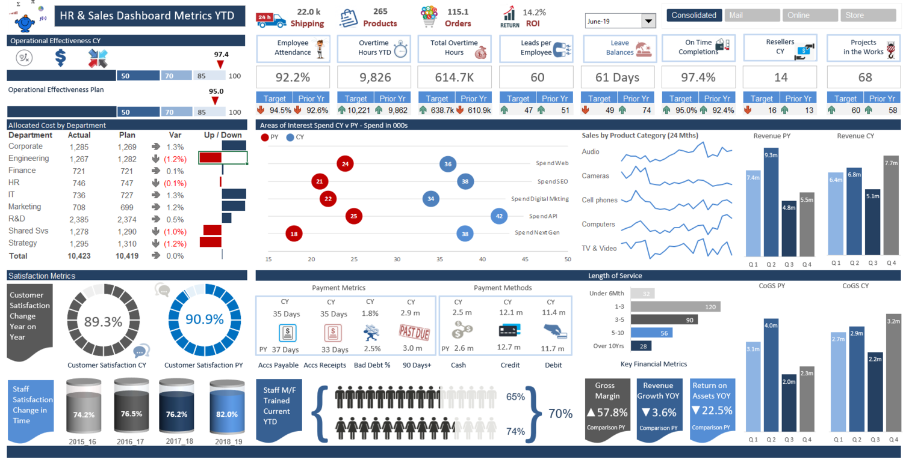
Sample Graphs and Dashboards
Simple
Too busy!

Slide 22
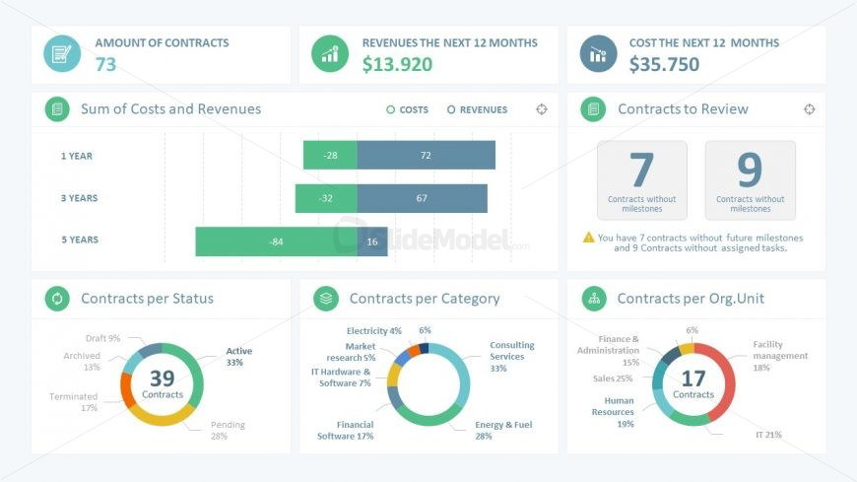
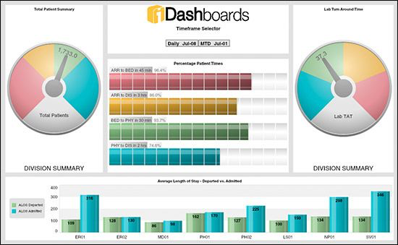
Sample Graphs and Dashboards
Combining graphs and numbers
Dials and colors

Slide 23
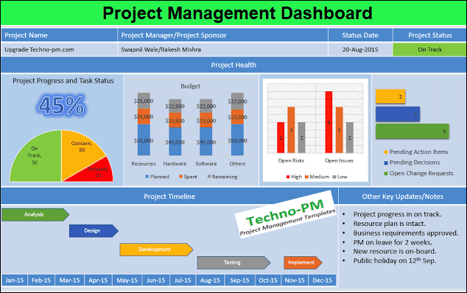
Sample Graphs and Dashboards

